Slide 1



Slide 2
JPA and Hibernate

Slide 3


Topics
What is JPA?
What is ORM?
What is Hibernate?
Persistence Concepts
JPA Annotations
Entity Relationships
Relationship Mapping
Cascade and Fetch
JPQL

Slide 4
What is JPA?
Specification for the management of persistence and object/relational mapping with Java
Persistence: Data objects shall outlive the JVM app
Objective: provide an object/relational mapping facility for Java developers using a Java domain model and a relational database
Map Java POJOs to relational databases (which are one type of persistence)
Standardized under the Java Community Process Program with contributions from Hibernate, TopLink, JDO, and the EJB community
Hibernate: Full JPA implementation with additional “native” features, e.g.,
HQL (Hibernate Query Language)
Criteria API

Slide 5
What is ORM?
ORM stands for Object-Relational Mapping (ORM) is a programming technique for converting data between relational databases and object oriented programming languages such as Java, C# etc.
An ORM system has following advantages over plain JDBC
Lets business code access objects rather than DB tables.
Hides details of SQL queries from OO logic.
No need to deal with the database implementation.
Entities based on business concepts rather than database structure.
Transaction management
Fast development of application.

Slide 6

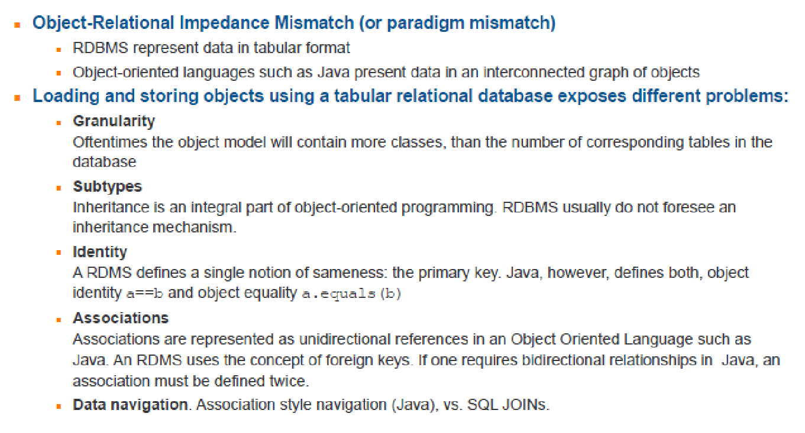
ORM – Why objects and databases do not play together

Slide 7
JPA
Now, you can see:
01. What is JPA
02. History of JPA
03. The Problem
04. The Solution
http://youtu.be/jhkFy6lW3Us
http://youtu.be/nYWtBwZGcbk
http://youtu.be/1UytHnHDYh4
http://youtu.be/RVBbcZImwgE

Slide 8
JPA
Now, you can see:
05. Why Use JPA
06. What Is JPA Again
07. JPA Providers
http://youtu.be/wBL_bEswGuU
http://youtu.be/-AHuYLqTwNM
http://youtu.be/Gl1Qud-xjvQ

Slide 9
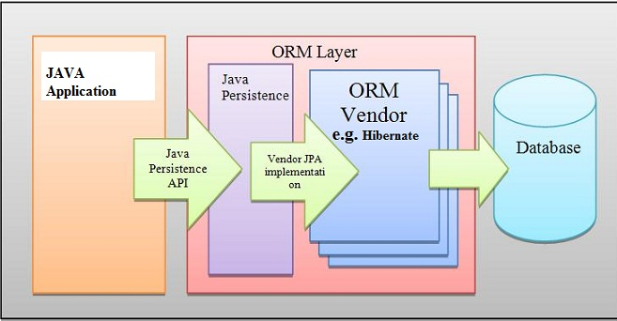
JPA

Slide 10
What is Hibernate
Hibernate is a high-performance Object/Relational persistence and query service which is licensed under the open source GNU Lesser General Public License (LGPL) and is free to download. Hibernate not only takes care of the mapping from Java classes to database tables (and from Java data types to SQL data types), but also provides data query and retrieval facilities.
It officially maintained by JBoss Inc., started in 2001

Slide 11
Differences between Hibernate and JDBC
JDBC | Hibernate
JDBC is a persistence technology | Hibernate is a persistence Framework.
In JDBC developer is responsible to taking and closing the connection and also write the SQL statement. | In Hibernate HRS(Hibernate Runtime System) is responsible for taking the connections, creating the statement and releasing the connections.
As table changed or database changed then it’s essential to change object structure as well as to change code written to map table-to-object/object-to-table. | The actual mapping between tables and application objects is done in XML files. If there is change in Database or in any table then the only need to change XML file properties.
Low performance and not scalable | High performance and scalable
it is developer’s responsibility to handle JDBC result set and convert it to Java objects through code to use this persistent data in application. | Hibernate reduces lines of code by maintaining object-table mapping itself and returns result to application in form of Java objects.

Slide 12
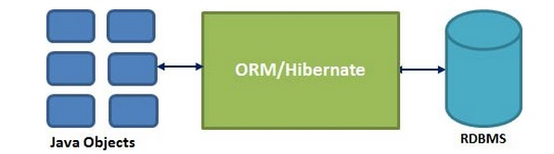
Hibernate
Hibernate is an Object-Relational Mapping(ORM) solution for JAVA and it raised as an open source persistent framework created by Gavin King in 2001. It is a powerful, high performance Object-Relational Persistence and Query service for any Java Application.
Hibernate maps Java classes to database tables and from Java data types to SQL data types and relieve the developer from 95% of common data persistence related programming tasks.
Hibernate sits between traditional Java objects and database server to handle all the work in persisting those objects based on the appropriate O/R mechanisms and patterns.

Slide 13
Hibernate
Now, you can see:
08. Hibernate Influence
http://youtu.be/UoCBvC9DS_Y

Slide 14
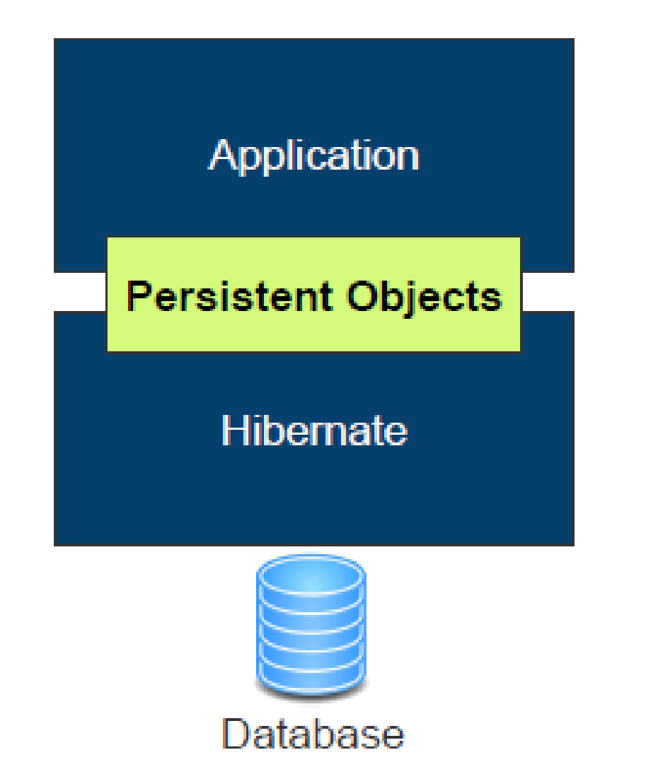
Hibernate Architecture

Slide 15
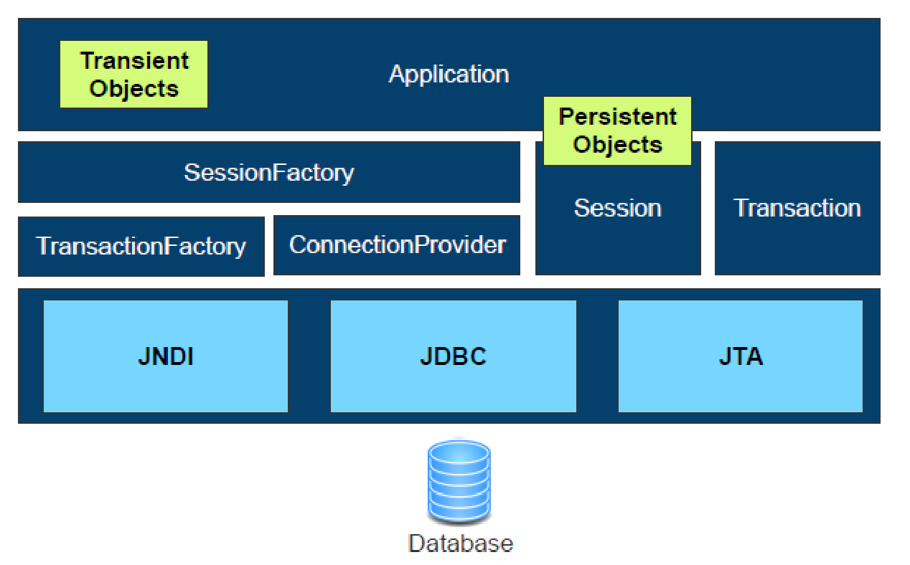
Hibernate Architecture

Slide 16
Hibernate - Advantages
Hibernate takes care of mapping Java classes to database tables using XML files and without writing any line of code.
Provides simple APIs for storing and retrieving Java objects directly to and from the database.
If there is change in Database or in any table then the only need to change XML file properties.
Abstract away the unfamiliar SQL types and provide us to work around familiar Java Objects.
Hibernate does not require an application server to operate.
Manipulates Complex associations of objects of your database.
Provides Simple querying of data

Slide 17
Hibernate - Advantages
Hibernate supports almost all the major RDBMS. Following is list of few of the database engines supported by Hibernate.
HSQL Database Engine
DB2/NT
MySQL
PostgreSQL
FrontBase
Oracle
Microsoft SQL Server Database
Sybase SQL Server
Informix Dynamic Server

Slide 18
Persistent Entities
Now, you can see:
09. What Is An Entity
http://youtu.be/VVpGl7cxEUA

Slide 19
Persistent Entities
Are POJOs (Plain Old Java Objects)
Lightweight persistent domain object
Typically represent a table in a relational database
Each entity instance corresponds to one row in that table
Have a persistent identity
May have both, persistent and transient (non-persistent) state
Simple types (primitive data types, wrappers, enums)
Composite types (e.g., Address)
Non-persistent state (using identifier transient or @Transient annotation)

Slide 20
Persistence Concepts
^{Persistence Unit (PU)}
Defines a set of entity classes managed by the EntityManager instance in an application
Maps the set of entity classes to a relational database
^{Persistence Context (PC)}
Set of managed entity instances that exist in a particular data store
^{Runtime context}
^{Entity Manager (EM)}
API for interaction with the persistence context
Manipulates and controls the lifecycle of a persistence context
Creates and removes persistent entity instances
Finds entities using primary keys
^{Runs queries on entities}

Slide 21


Persistence Concepts – Persistence Unit
^{Persistence Unit}
Configuration to map entity classes in an application to a relational database
persistence.xml defines one or more persistence units
Defined under /conf/META-INF/persistence.xml
Classes with JPA annotations are automatically detected upon start of the application
Names must be referenced in application.conf
<persistence xmlns="http://java.sun.com/xml/ns/persistence" xmlns:xsi="http://www.w3.org/2001/XMLSchema-instance" xsi:schemaLocation="http://java.sun.com/xml/ns/persistence http://
java.sun.com/xml/ns/persistence/persistence_2_0.xsd" version="2.0">
<persistence-unit name="defaultPersistenceUnit" transaction-type="RESOURCE_LOCAL">
<provider>org.hibernate.ejb.HibernatePersistence</provider>
<non-jta-data-source>DefaultDS</non-jta-data-source>
<properties>
<property name="hibernate.dialect" value="org.hibernate.dialect.H2Dialect"/>
<property name="hibernate.hbm2ddl.auto" value="create" />
</properties>
</persistence-unit>
</persistence>

Slide 22
Persistence Concepts
Modify the contents of the web.xml to include the following:
A servlet and specify the location of the configuration file for the same. In this sample, a configuration file named springConfig.xml is created under WEB-INF/config folder in the project layout.
A servlet-mapping to map the servlet created in the above step that should be invoked when the client specifies the url matching the url pattern.
A ContextLoaderListener to integrate spring with the web application and provide the contextConfigLocation where the context files for JPA.

Slide 23
Persistence Concepts
Now, you can see:
10. persistence.xml
11. persistence.xml Demo
12. web.xml
13. web.xml Demo
http://youtu.be/4XqKvMhlZxE
http://youtu.be/XiaQwVIwEps
http://youtu.be/fTAMWzvBMUA
http://youtu.be/3bVCklny2LQ

Slide 24

Persistence Concepts – Entity Manager
^{API for managing entities}
Persistence Unit
Configuration in persistence.xml
EntityManager persist() remove() refresh() merge() find() contains() flush() createQuery()
createNamedQuery()
Managed Entity
Managed Entity
Play application
Persistence Context

Slide 25
Persistence Concepts
As defined in the web.xml, create a file named jpaContext.xml under the folder src/main/resources folder in the project to define JPA and Hibernate related configurations.
Note that any file created under src/main/resources folder in a maven project will be automagically added by Maven to the classpath.

Slide 26
Persistence Concepts
Now, you can see:
14. jpaContext.xml
15. jpaContext.xml Demo
16. Entity Manager Factory
17. Entity Manager Factory Demo
http://youtu.be/OFhqv9Vf2oQ
http://youtu.be/UUn70sIUlb4
http://youtu.be/-LumOrln0jc
http://youtu.be/pJzNw7EBXlU

Slide 27

Persistence Concepts – Entity Lifecycle
No longer associated with persistence context
PC ends
updates
new()
Detached Entity
New Entity
Persistence Context
merge()
persist()
Managed Entity
Managed Entity
Managed Entity
Transaction commit
Guaranteed scope of object identity
remove()
Only one managed entity in PC represents a row
Removed Entity
Entities in managed/persistent state may be manipulated by the application and any changes will be automatically detected and persisted when the persistence context is flushed. There is no need to call a particular method to make your modifications persistent.

Slide 28
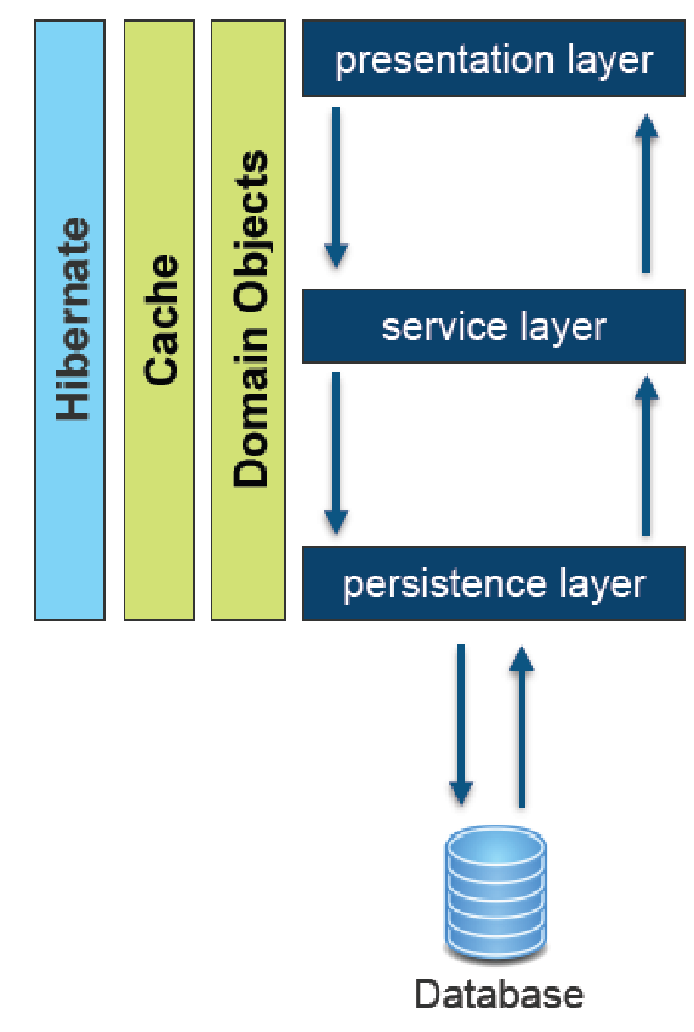
Persistence with Hibernate

Slide 29
Caveats
With JPA/Hibernate lots of “magic” is done under the hood, e.g., SQL-DDL is automatically generated
Know the database basics first, in order to fully understand what JPA is doing under the hood
After annotating the classes and running the application check the resulting SQL-DDL (e.g., using the database explorer in IntelliJ or Eclipse)
When executing SQL-Queries using JPA/Hibernate use the “show SQL queries” feature during development, in order to see what kind of queries are actually executed
Set <property name="hibernate.show_sql" value="true" /> in persistence.xml

Slide 30
Persistence Concepts
Now, you can see:
18. Transaction Overview
19. Transaction Configuration Demo
20. Datasource
21. Datasource Demo
http://youtu.be/CK7nkpcrHgk
http://youtu.be/KqAyb_W-t9k
http://youtu.be/afKShlEZLSs
http://youtu.be/6_UR0WOLEZY

Slide 31
Persistent Entities
Now, you can see:
22. JPA Properties Configuration.xml
23. Entity and JPA Config Demo
http://youtu.be/mRq2qpcq9m4
http://youtu.be/DIxQXz2kOvI

Slide 32
JPA Annotations
Now, you can see:
24. Annotation Config
http://youtu.be/hPtaHION8L0

Slide 33
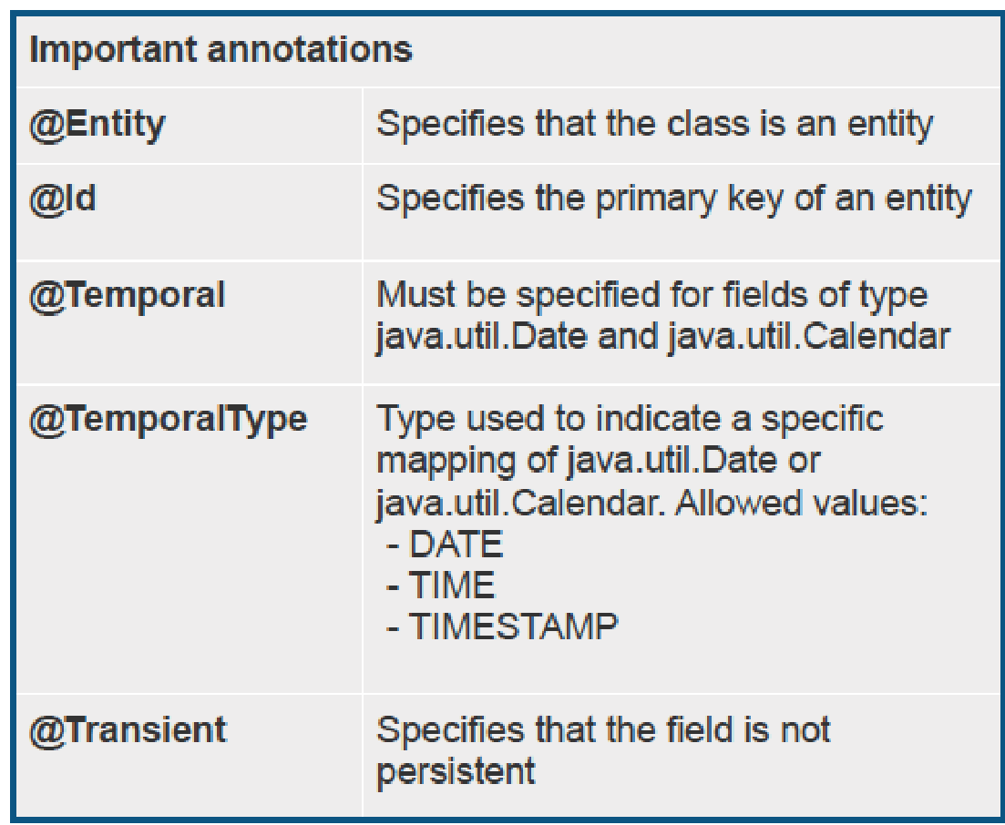
JPA Annotations

Slide 34
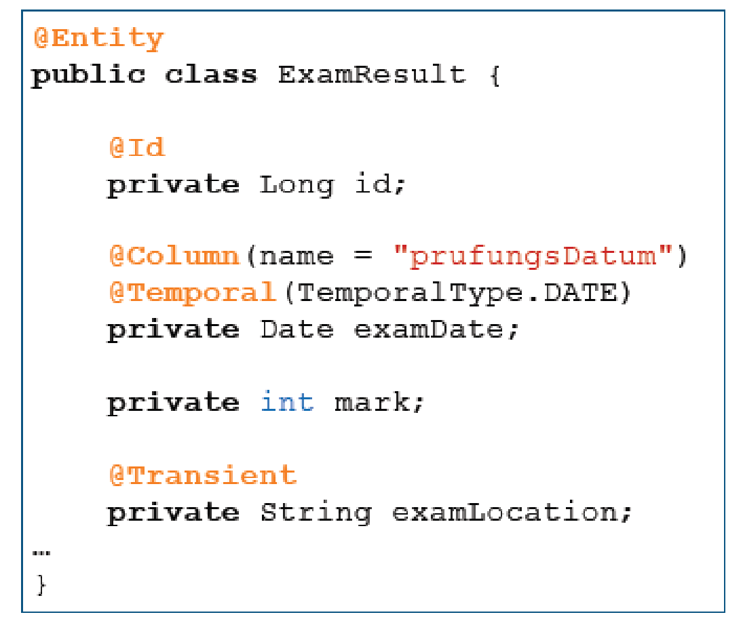
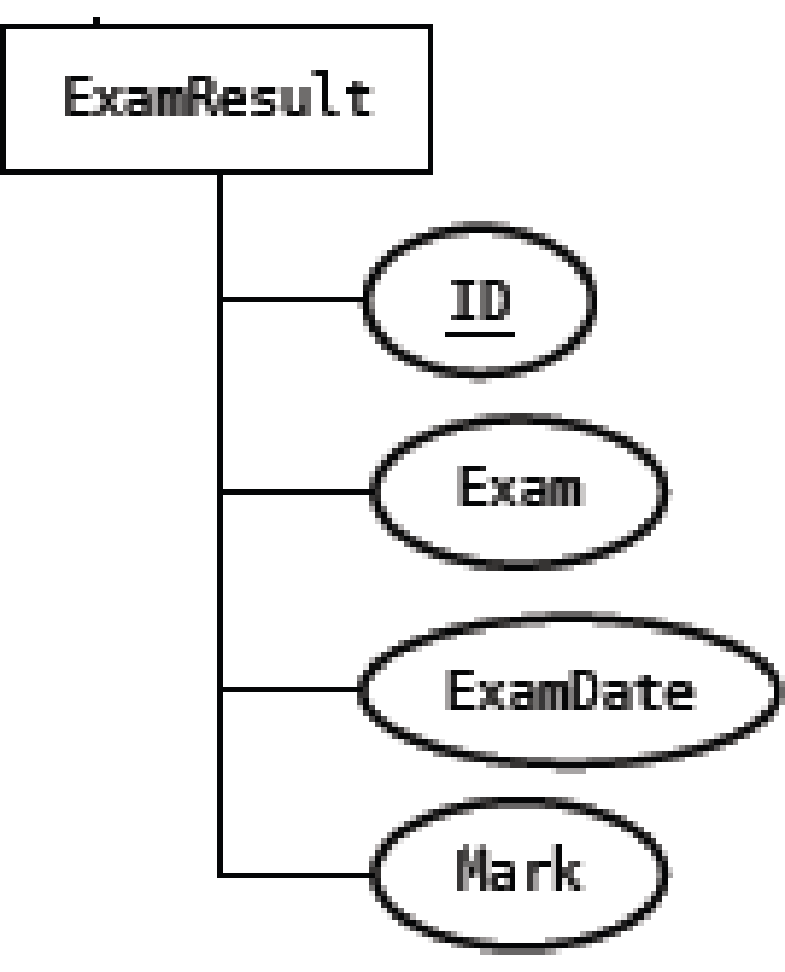

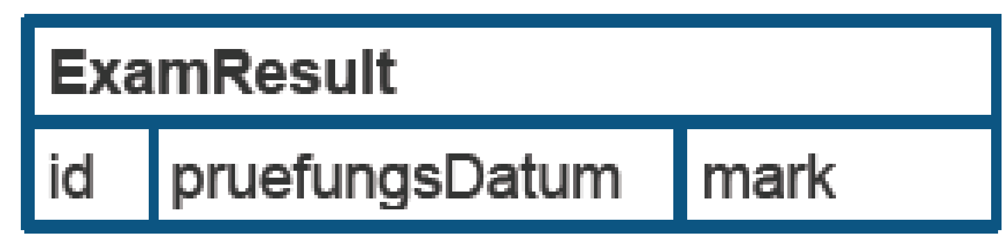
Simple Mapping

Slide 35
Simple Mapping
Now, you can see:
25. Annotation An Entity
26. Table Annotation Demo
27. Column Annotation
28. Column Annotation Demo
http://youtu.be/LLse7kxO19o
http://youtu.be/Ph-9uzqR9sY
http://youtu.be/UZlF-BJcrWQ
http://youtu.be/bF6Z6xIeobU

Slide 36
JPA Annotations
Now, you can see:
29. How Do We Start Using It
30. Service Configuration Demo
31. Repository Configuration Demo
32. End-to-end Demo
http://youtu.be/ssajixeyqDg
http://youtu.be/iowiC4fHeiU
http://youtu.be/J0HSC_0_hao
http://youtu.be/hT4OT07Rfp8

Slide 37
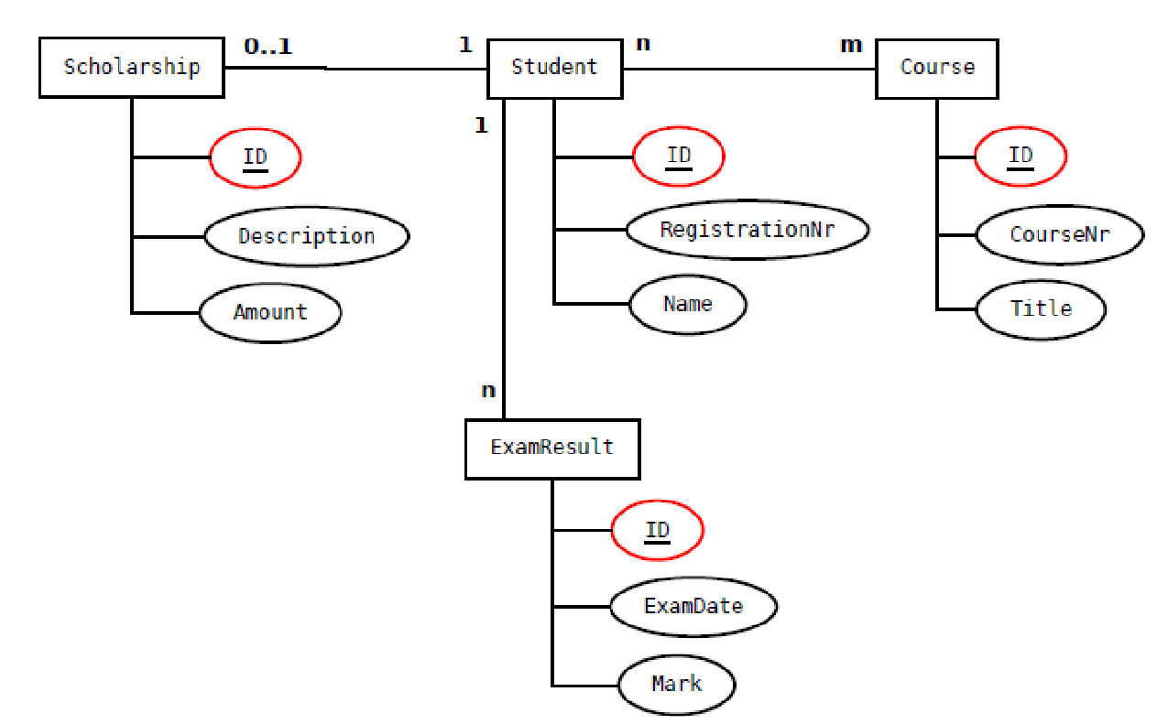
Simple Mapping – Inheritance

Slide 38
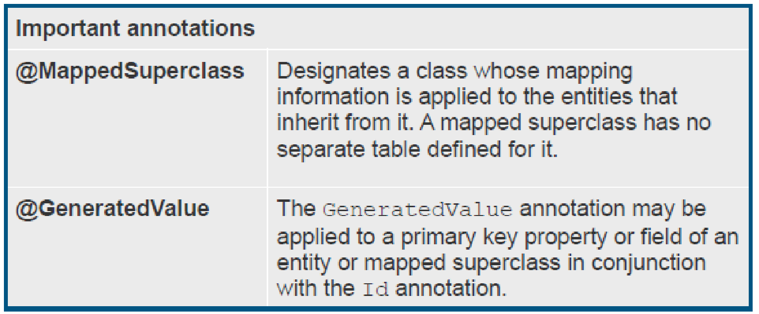
JPA Annotations

Slide 39
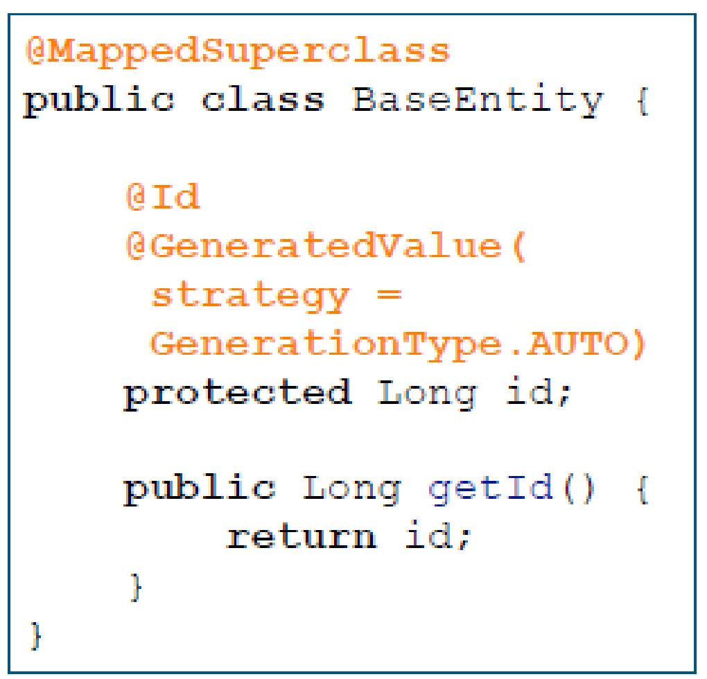
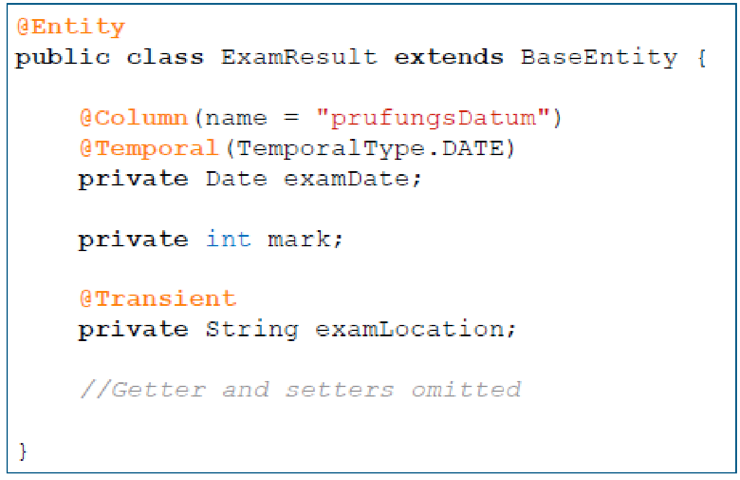

JPA Annotations

Slide 40
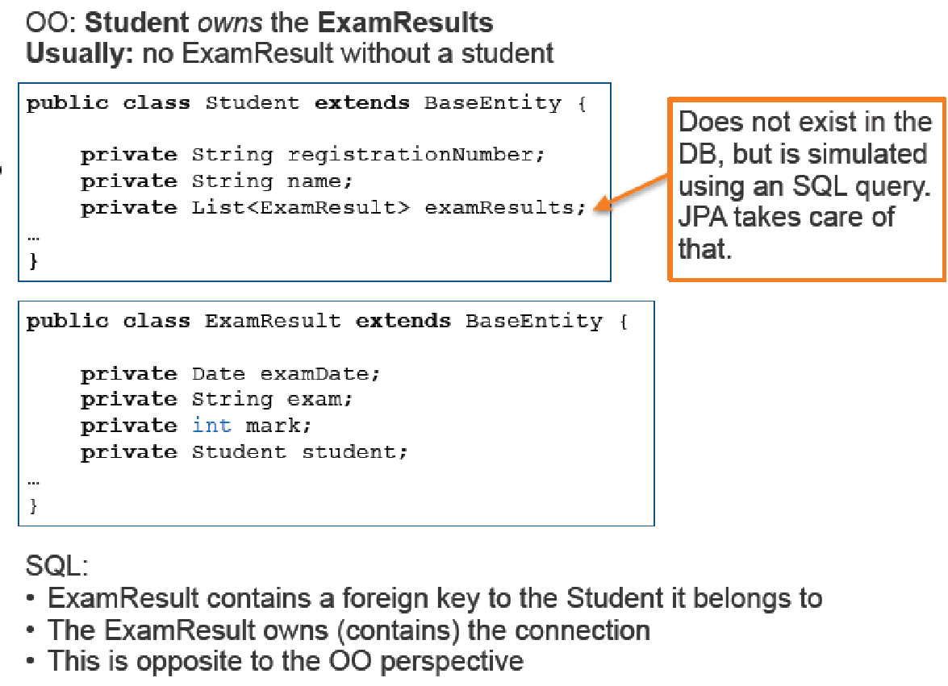
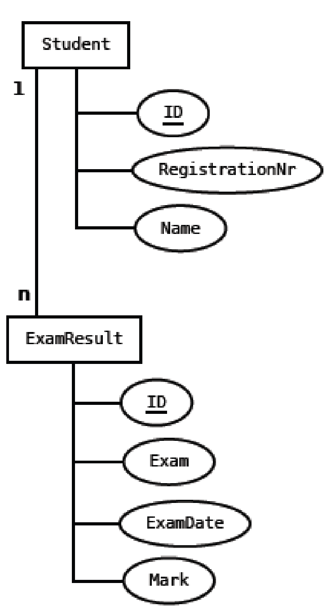
Object-Oriented vs SQL

Slide 41
Entity Relationships
One-to-one, one-to-many, many-to-many, many-to-one relationships
among entities
• bi-directional or uni-directional
• Support for different Collection types, e.g., List, Set, Map, etc.
Need to specify the owning side in relationships
• Owning side table has the foreign key
• OneToOne relationship - the side where the foreign key is specified
• OneToMany, ManyToOne - the “many” side

Slide 42
Entity Relationships
Now, you can see:
33. Join Types
http://youtu.be/9KhAonYLe1g

Slide 43
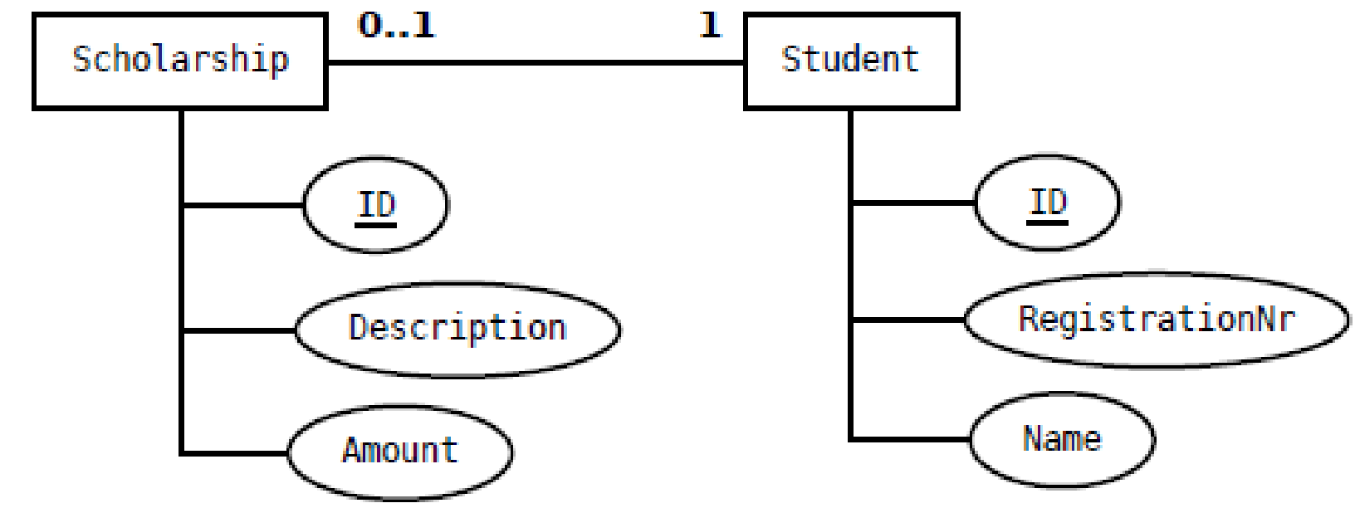
Relationship Mapping – Unidirectional Mapping
Four different options:
1. Using an embedded table, where Scholarship is the embedded table. (see example)
2. Scholarship and Student are separate tables. The primary key of Scholarship has a foreign key constraint on the primary key of the “owning” Student (using @PrimaryKeyJoinColumn annotation)
3. Scholarship and Student are separate tables. Student holds a foreign key which references the primary key of Scholarship. The foreign key has a unique constraint.
4. Scholarship and Student are separate tables. Scholarship holds a foreign key which references the primary key of Student. The foreign key has a unique constraint. (see example)

Slide 44
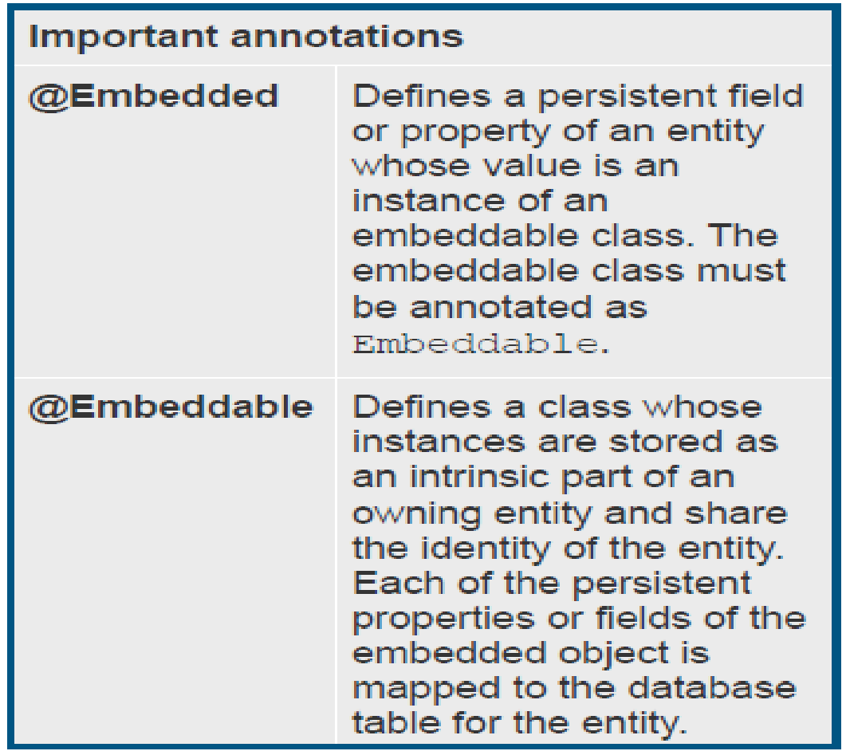
Relationship Mapping – Unidirectional OneToOne
Unidirectional OneToOne using an embedded table

Slide 45
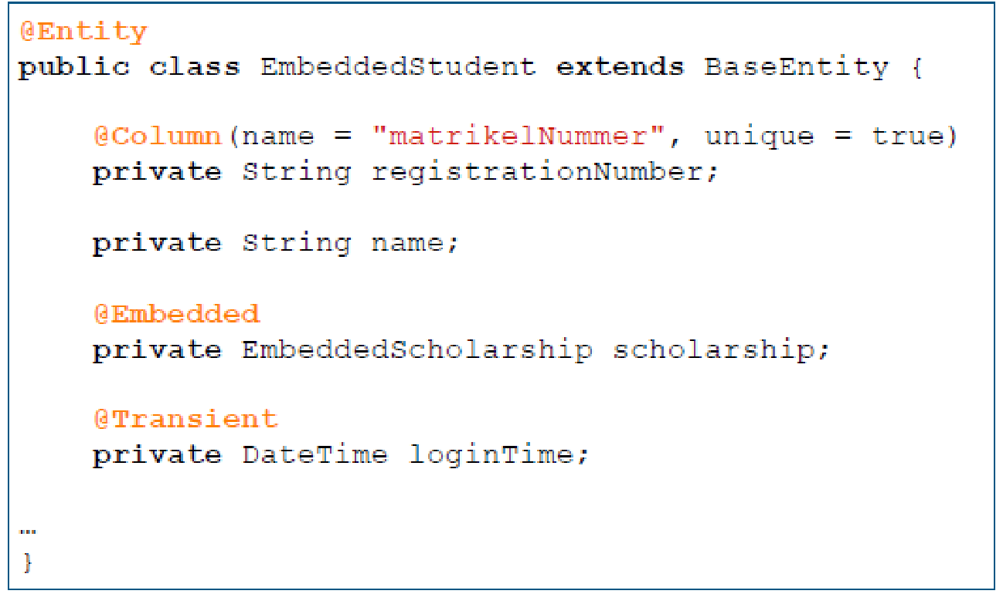
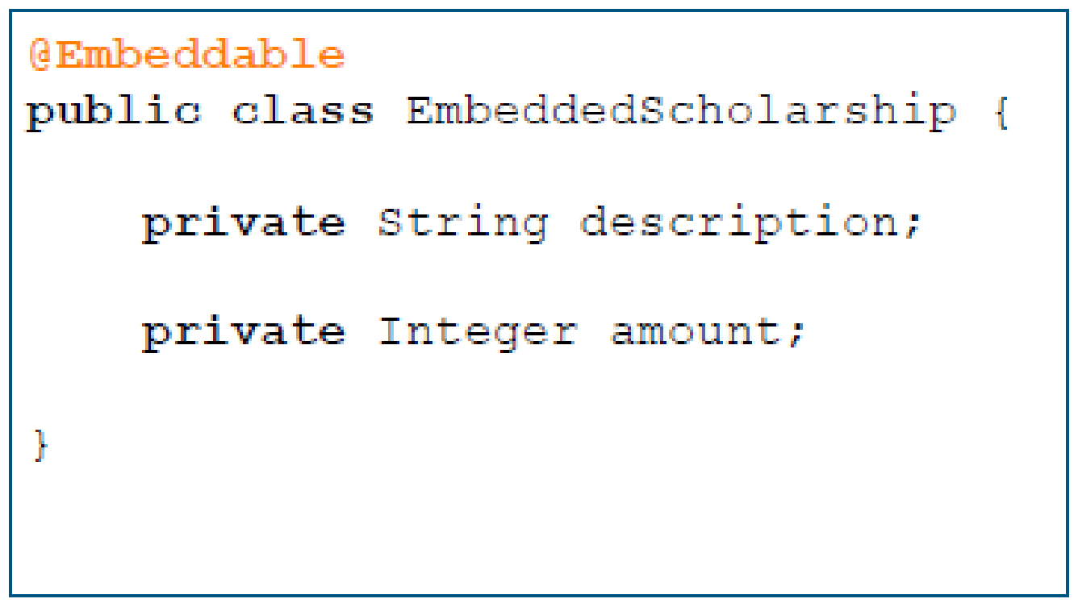
Relationship Mapping – Unidirectional OneToOne
Unidirectional OneToOne using an embedded table
Might be an issue with legacy databases, where the
DB schema already exists and must not be altered.

Slide 46
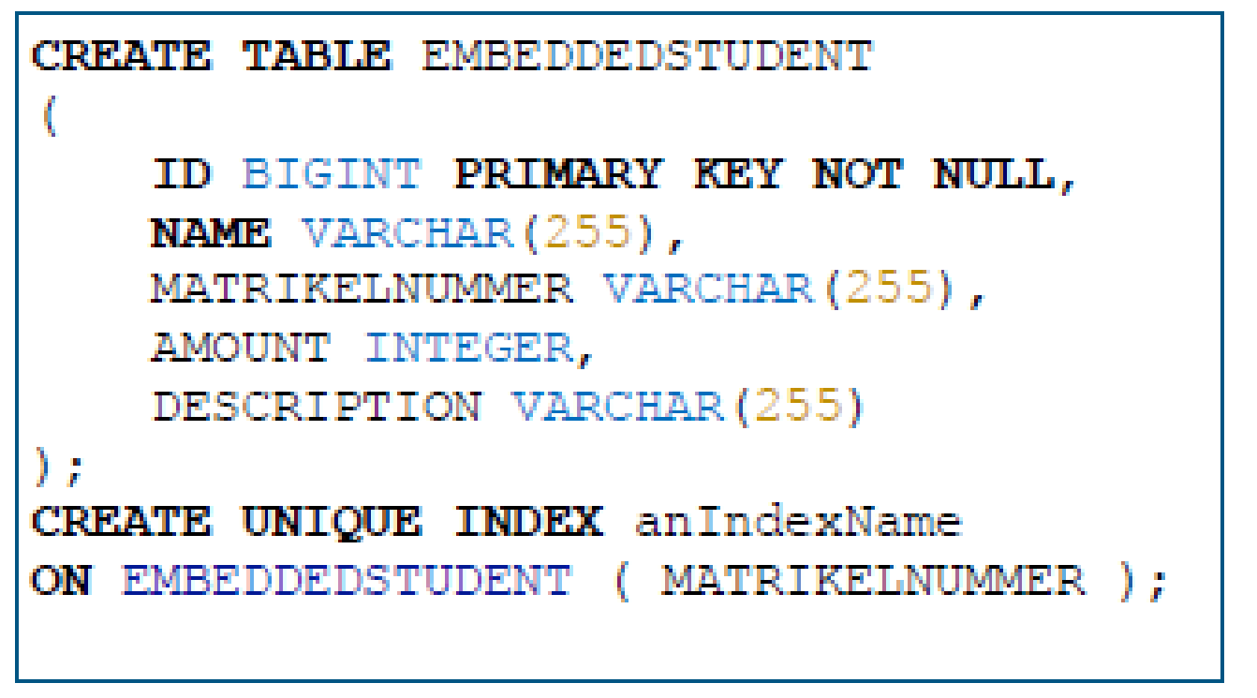
Relationship Mapping – Unidirectional OneToOne
Unidirectional OneToOne using an embedded table – resulting SQL-DDL

Slide 47
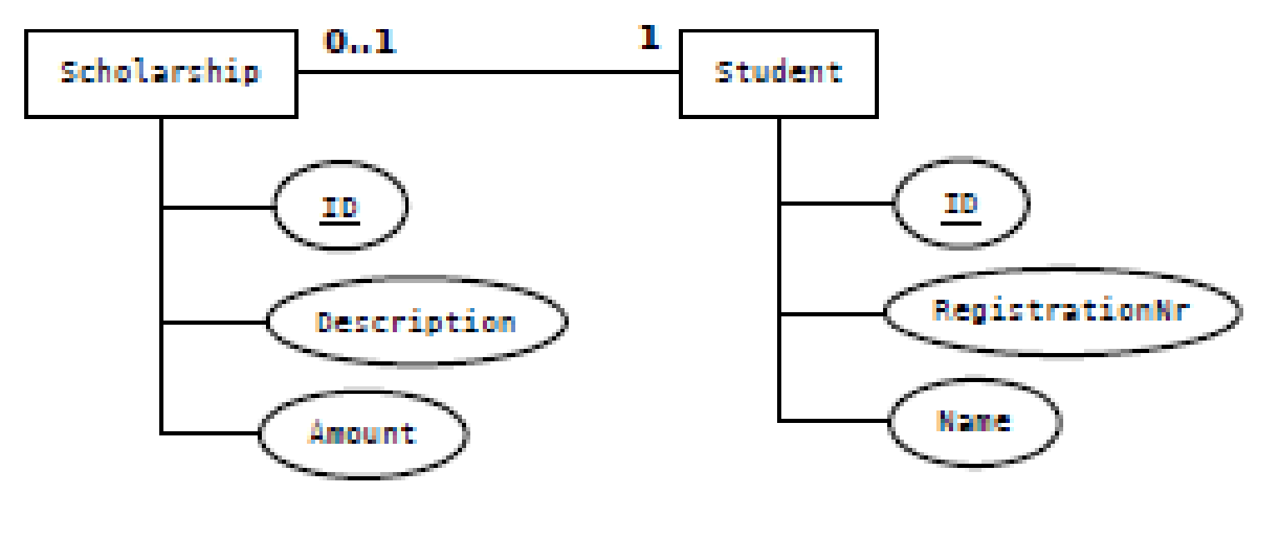
Relationship Mapping – Bidirectional OneToOne
Bidirectional OneToOne using foreign key

Slide 48
Relationship Mapping – Bidirectional OneToOne
Bidirectional OneToOne using foreign key
Important annotations
@OneToOne | Defines a single-valued association to another entity that has one-to- one multiplicity.
@FetchType | LAZY = do not load referenced entity, until it is accessed for the first time EAGER = load referenced entity immediately
@CascadeType | Defines the set of cascadable operations that are propagated to the associated entity. ALL is equivalent to cascade={PERSIST, MERGE, REMOVE, REFRESH, DETACH}
mappedBy | References the field that “owns” the relationship in the referenced entity. Required unless the relationship is unidirectional.

Slide 49
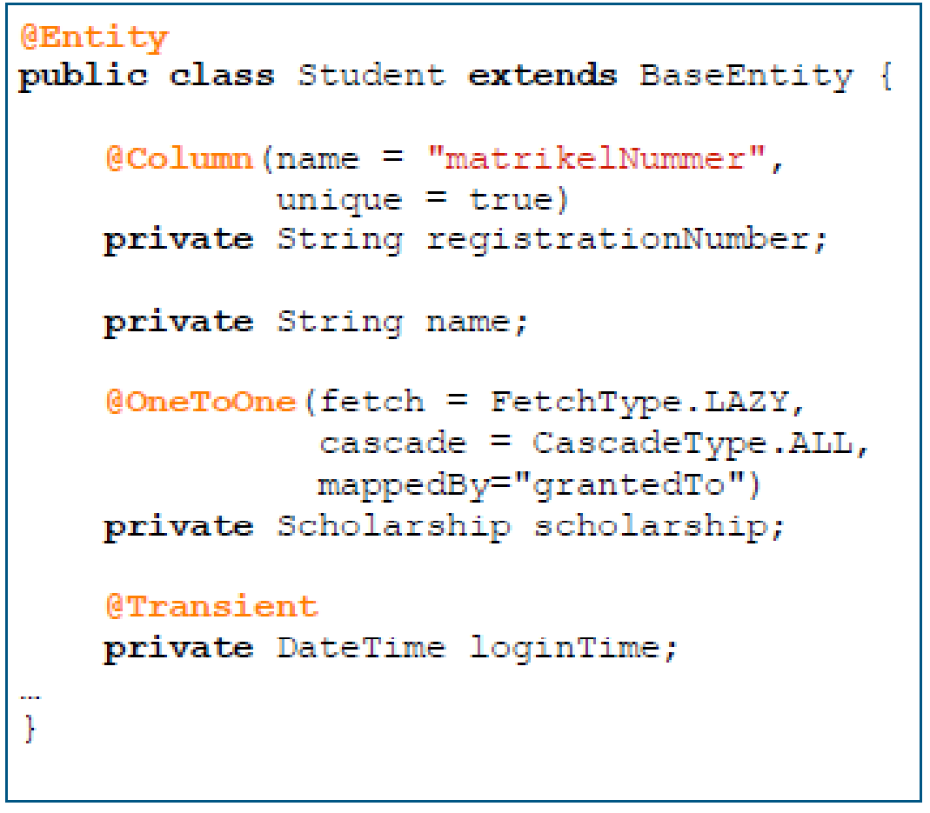
Relationship Mapping – Bidirectional OneToOne
Bidirectional OneToOne using foreign key
The “non-owning” side

Slide 50
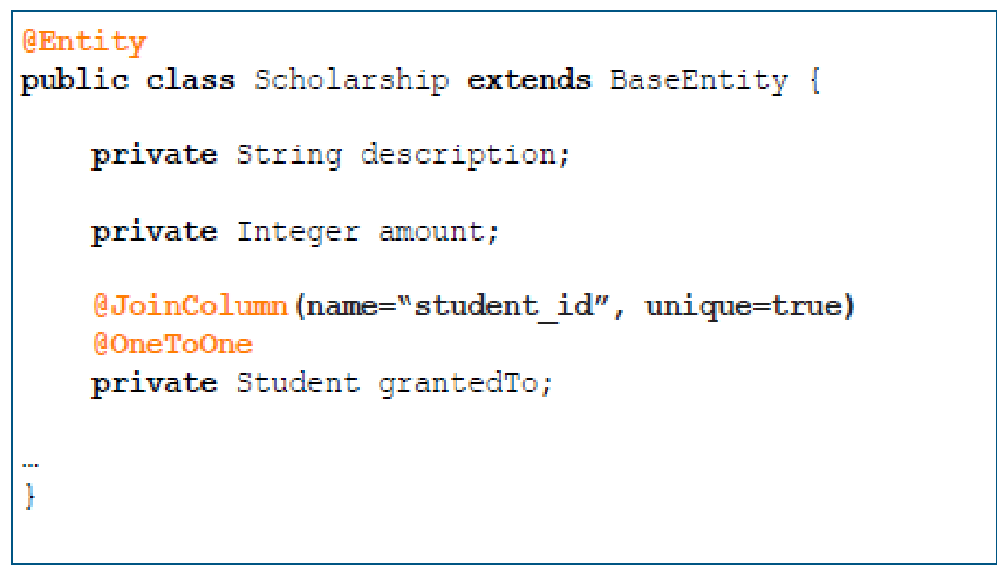
Relationship Mapping – Bidirectional OneToOne
Bidirectional OneToOne using foreign key
The “owning” side
Important annotations
@JoinColumn | Specifies a column for joining an entity association or element collection. In this case: the name of the column, where the foreign key will be stored.

Slide 51
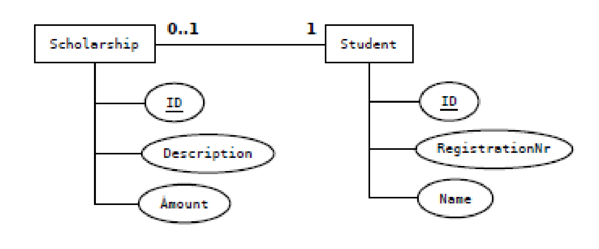
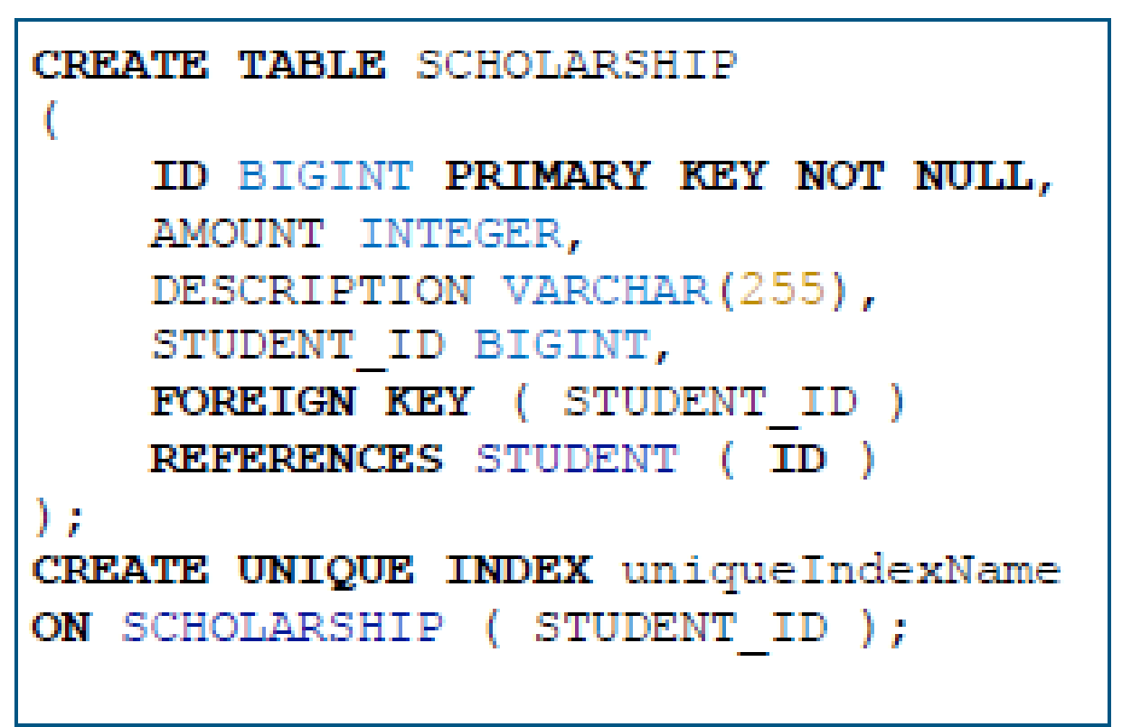
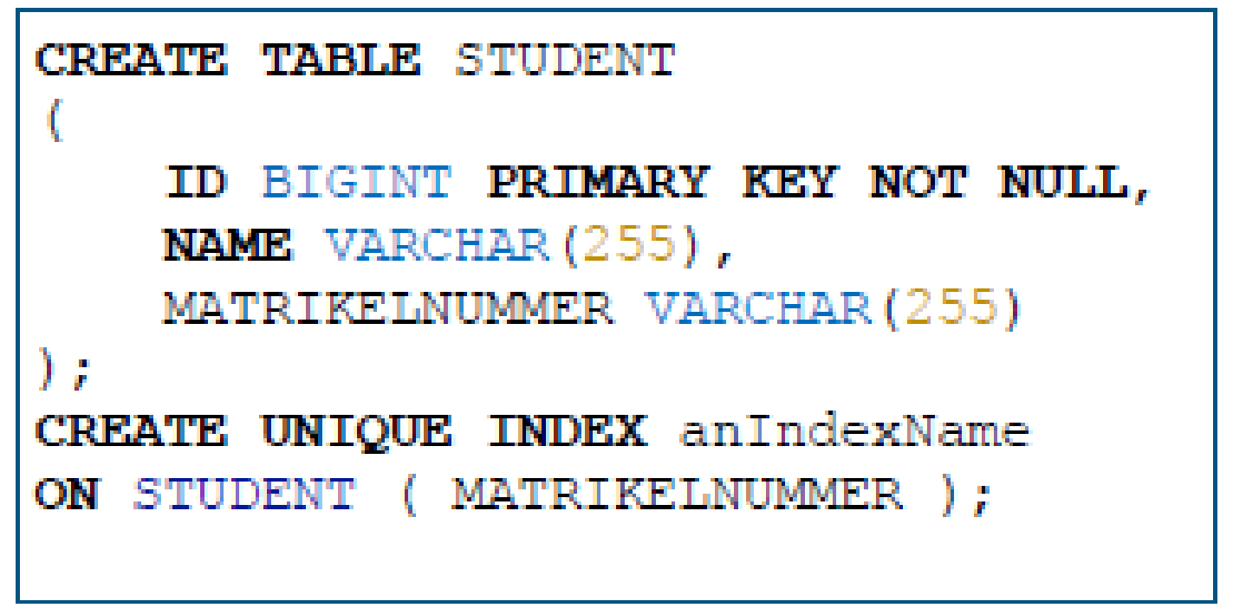
Relationship Mapping – Bidirectional OneToOne
Bidirectional OneToOne using foreign key - resulting SQL-DDL

Slide 52
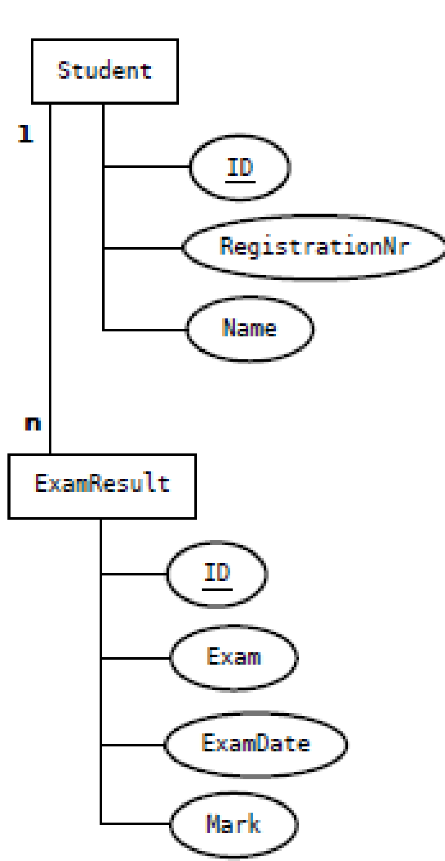
Relationship Mapping – Bidirectional OneToMany
Bidirectional OneToMany

Slide 53
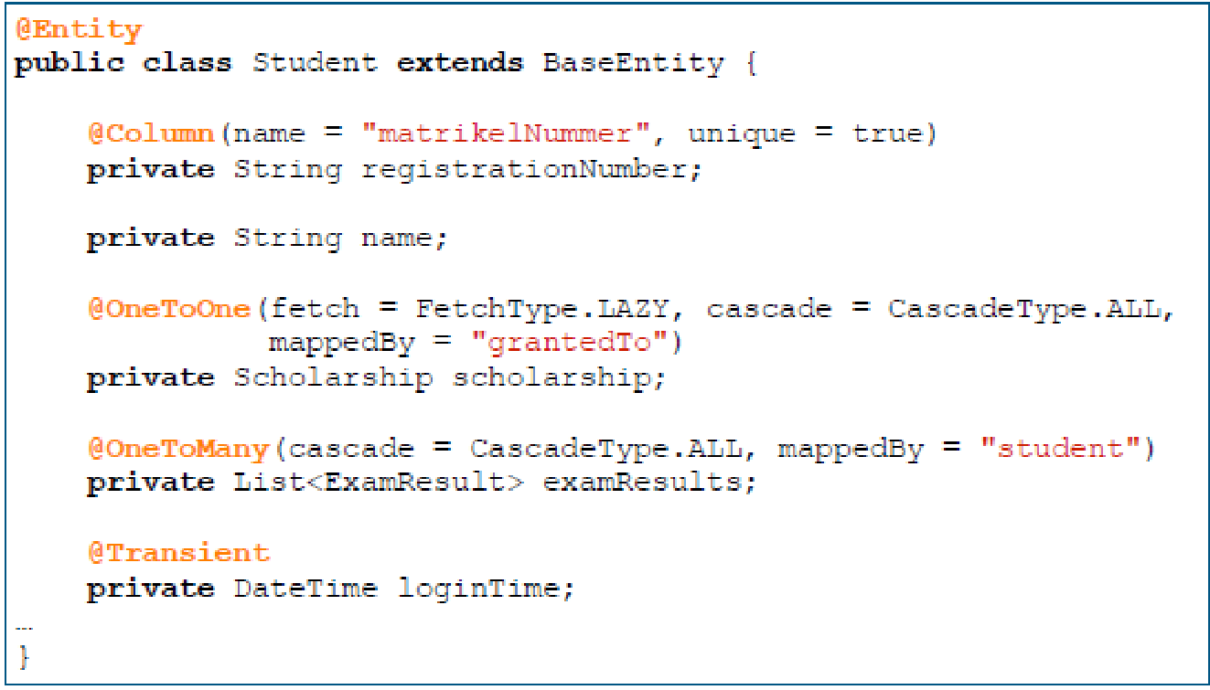
Relationship Mapping – Bidirectional OneToMany
Bidirectional OneToMany
The “non-owning” side
Important annotations
@OneToMany | Defines a many-valued association with one-to-many multiplicity.

Slide 54
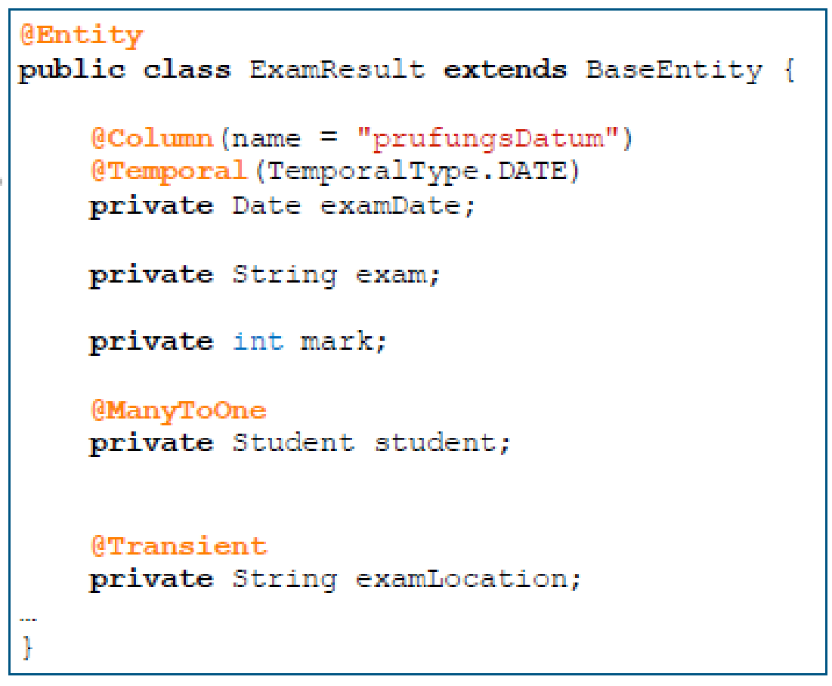
Relationship Mapping – Bidirectional OneToMany
Bidirectional OneToMany
The “owning” side
Important annotations
@ManyToOne | Defines a single-valued association to another entity class that has many-to-one multiplicity.

Slide 55
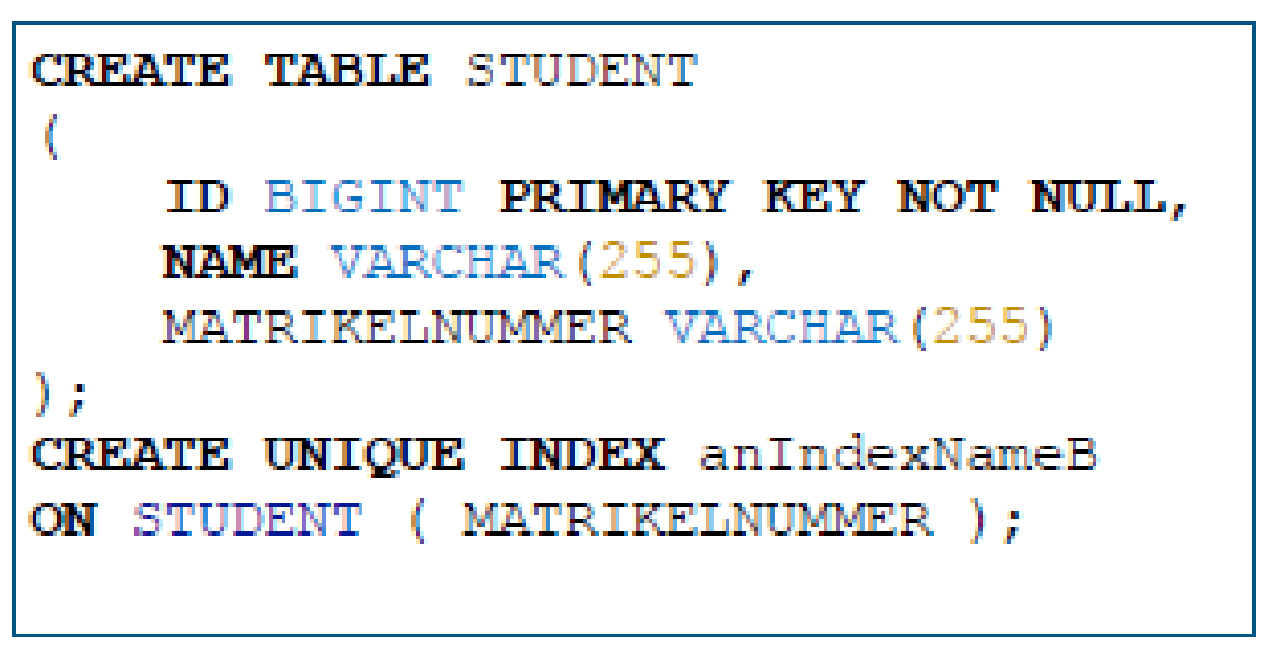
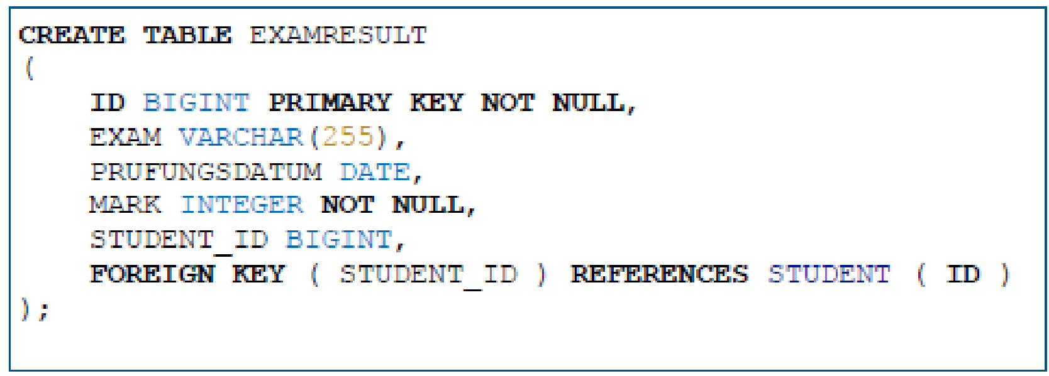
Relationship Mapping – Bidirectional OneToMany
Bidirectional OneToMany – resulting SQL-DDL

Slide 56
Relationship Mapping –OneToMany
Now, you can see:
34. One-to-many
35. Annotating The Exercise Object Demo
36. One-to-many Demo
37. Many-to-one Demo
http://youtu.be/-e3n2UsY6NY
http://youtu.be/6rVW8arW7IM
http://youtu.be/JMyOxEqNM2I
http://youtu.be/VWBVm4B6D54

Slide 57
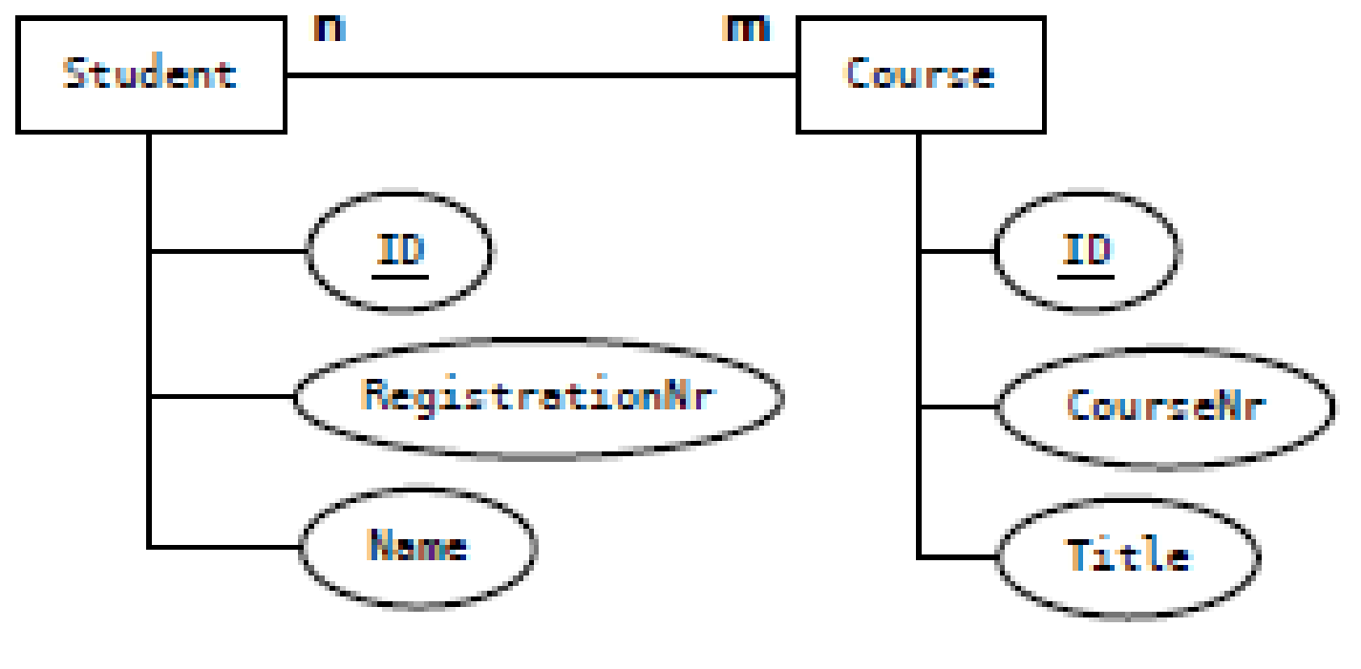
Relationship Mapping – ManyToMany
ManyToMany
Important annotations
@ManyToMany | Defines a many- valued association with many-to-many multiplicity.

Slide 58
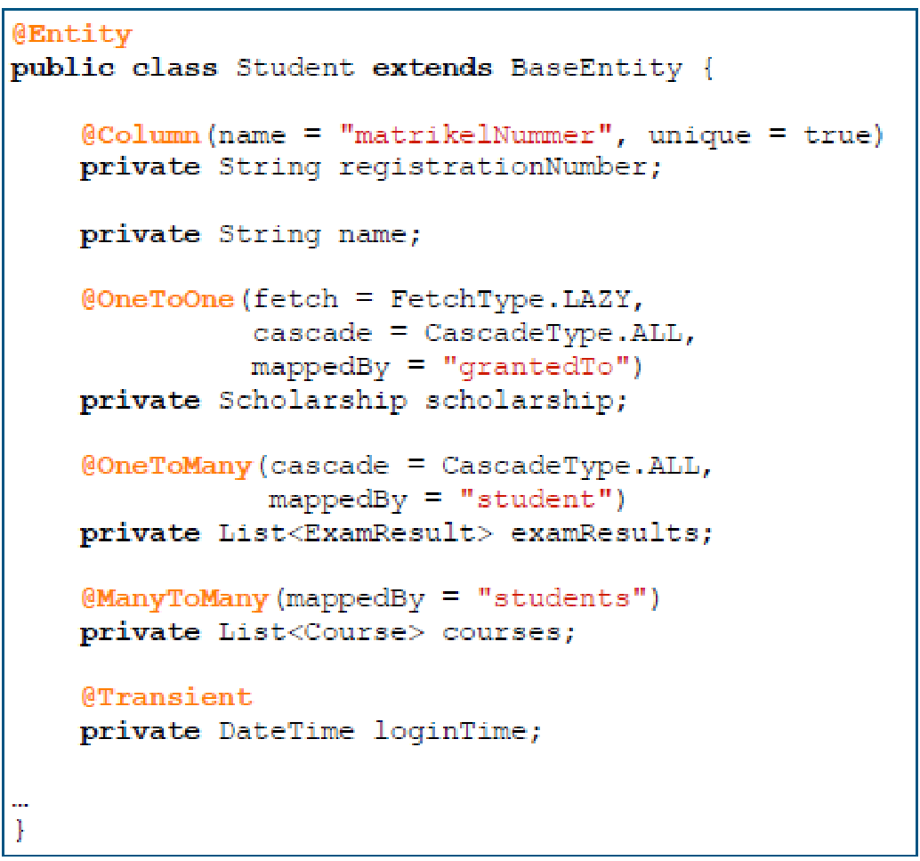
Relationship Mapping – ManyToMany
ManyToMany

Slide 59
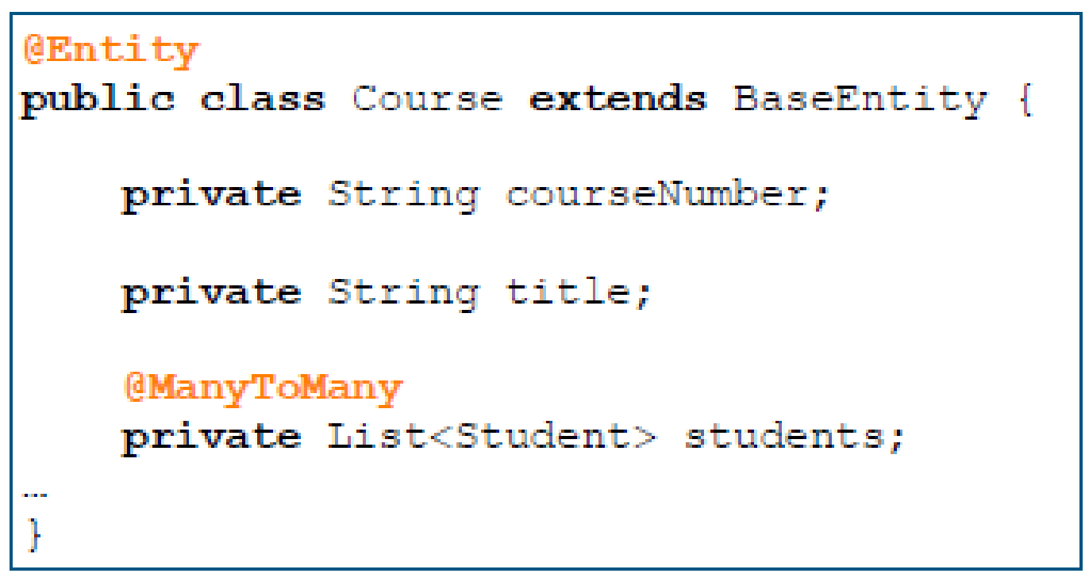
Relationship Mapping – ManyToMany
ManyToMany

Slide 60
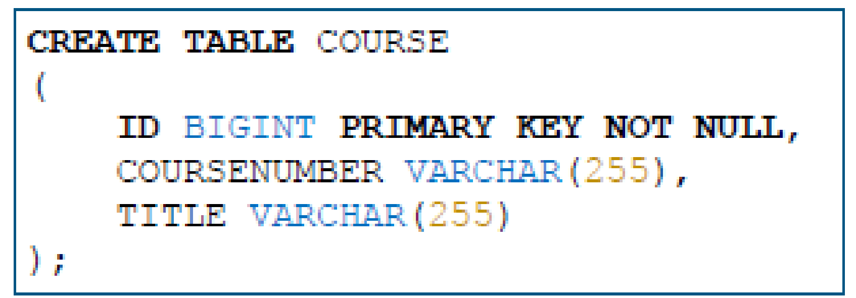
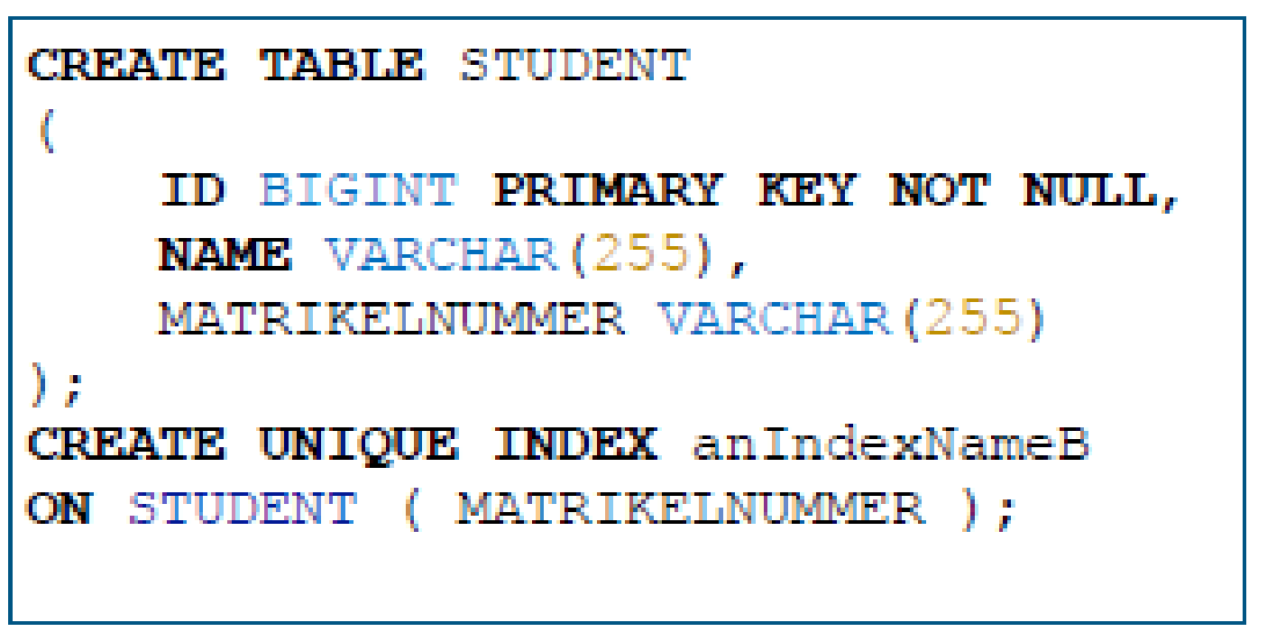
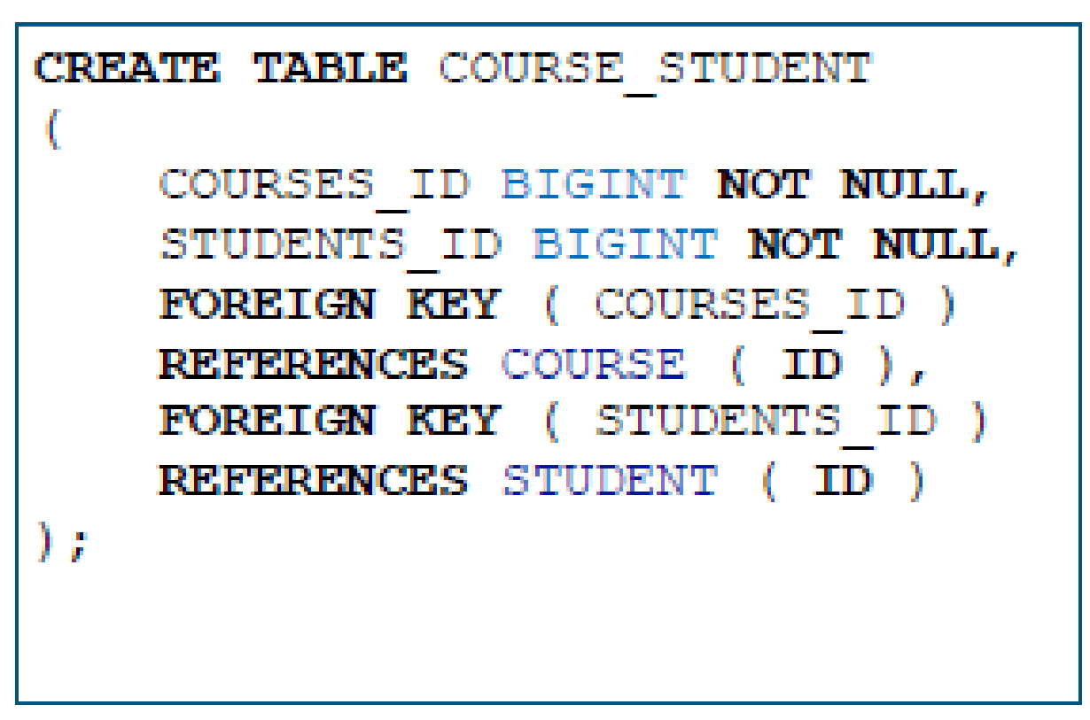
Relationship Mapping – ManyToMany
ManyToMany – resulting SQL-DDL

Slide 61
Cascade and Fetch
^{Cascade Types}
All four relationship annotations may specify operations cascaded to associated entities
ALL, PERSIST, MERGE, REMOVE, REFRESH, DETACH
^{Default is none}
^{Orphan Removal}
For @OneToOne and @OneToMany relationships
^{Default is false}

Slide 62
Cascade and Fetch
^{Fetching Strategies}
Define how object hierarchies are loaded
EAGER = load all related objects immediately
LAZY = load the related objects only if they are accessed for the first time
Be careful with EAGER, as large object graphs may be loaded unintentionally!

Slide 63
Fetch
Now, you can see:
38. Fetch Types
http://youtu.be/tU55DB0neCE

Slide 64
Persistence Concepts – Entity Manager samples
Typically one addresses the entity manager from a dedicated persistence service class
public void persist(BaseEntity entity){ em().persist(entity);
}
Make an entity instance managed and persistent. Throws EntityExistsException, if the entity instance already exists.
public <T extends BaseEntity> T merge(T entity) {
return em().merge(entity);
}
Make an entity instance managed and persistent. If it does not exist yet, persist it. If it already exists, the entity instance is updated.
public <T extends BaseEntity> T findEntity(Long id, Class<T> entityClazz) {
return em().find(entityClazz, id);
}
Find the entity instance using the primary key.
public void remove(BaseEntity entity){ em().remove(entity);
}
Remove the instance.

Slide 65
Persistence Concepts – Finding Entities
Find entity by primary key using EntityManager
<T> T find(Class<T> entityClass, Object primaryKey)
^{Example:}
Student student = entityManager.find(Student.class, id);

Slide 66
Persistence Concepts – Finding Entities
^{For complex queries use}
Java Persistence Query Language (JPQL) or Hibernate Query Language (HQL)
Both are object model focused query languages similar in nature to SQL.
JPQL is a heavuly-inspired-by subset of HQL
A JPQL query is always a valid HQL query, the reverse is not true however.
^{Criteria API}
^{Native Queries}
EntityManager provides methods for creating Query objects
^{createQuery}
createNativeQuery (using plain SQL - not recommended)

Slide 67
JPQL/HQL
^{Similar to SQL}
Works with entities as defined in the application and *not* with SQL table names and attribute names
Portable (they abstract from vendor-specific SQL)
Returns entities (no need to worry about result sets and their manual conversion to POJOs)
Select, update, delete
Support for
^{Joins}
^{Conditional Expressions}
^{Functional Expressions}
^{Subqueries}
^{Order by, group by, having}
….

Slide 68
JPQL
Now, you can see:
39. JPQL
40. JPQL Demo
http://youtu.be/koqUcWcr2sQ
http://youtu.be/rh0ufwdCvp0

Slide 69
Fetch
Now, you can see:
41. OpenEntityManagerInViewFilter
42. Lazy Initialization Fix Demo
http://youtu.be/UETEf0n5UB4
http://youtu.be/gif3LnqoPu8

Slide 70
Querying Entities with JPQL
^{Dynamic Query}
Use parameter substitution and do not concatenate the JPQL string with the parameter values
public List<Student> getStudentByName(String studentName) {
TypedQuery<Student> studentTypedQuery =
em().createQuery("SELECT s FROM Student s WHERE s.name LIKE :studentName", Student.class);
studentTypedQuery.setParameter("studentName", studentName);
return studentTypedQuery.getResultList();
}

Slide 71
Querying Entities with JPQL
Now, you can see:
43. Projection
44. Projection Demo
http://youtu.be/DNdHGq_s9xw
http://youtu.be/D3LghZfDtSQ

Slide 72
Querying Entities with JPQL
^{Static Query}
^{Named Query}
Recommended, as it may leverage use of query cache
|
@NamedQuery(name="findAllStudents", query="SELECT s FROM Student s")
@Entity
public class Student extends BaseEntity {
…
}
public List<Student> getAllStudents() {
List<Student> students =
em().createNamedQuery("findAllStudents", Student.class).getResultList();
return students;
}

Slide 73
Querying Entities with JPQL
Now, you can see:
45. Named Queries
46. Named Queries Demo
http://youtu.be/4tp-1_oDCAU
http://youtu.be/NbIs8jy_Naw

Slide 74
Criteria API
Alternative to JPQL, same scope
^{Dynamic Queries only}
Clauses are set using Java programming language objects
the query can be created in a typesafe manner
Obtain a CriteriaBuilder instance by using the EntityManager.getCriteriaBuilder method.

Slide 75
Querying Entities with Criteria API
public Student getStudent(String registrationNumber) {
CriteriaBuilder cb = em().getCriteriaBuilder();
CriteriaQuery<Student> criteriaQuery = cb.createQuery(Student.class);
Root<Student> s = criteriaQuery.from(Student.class);
ParameterExpression<String> parameter = cb.parameter(String.class);
criteriaQuery.select(s).where(cb.equal(s.get("registrationNumber"), parameter));
TypedQuery<Student> typedQuery = em().createQuery(criteriaQuery);
typedQuery.setParameter(parameter, registrationNumber);
return typedQuery.getSingleResult();
}

Slide 76
Querying Entities with Hibernate Criteria
public List<ExamResult> getNegativeExamResults(Student student) {
Criteria c = ((Session) JPA.em().getDelegate()).createCriteria(Student.class);
c.createCriteria("examResults").add(Restrictions.eq("mark", 5));
return c.list();
}

Slide 77

Thank You

